Slide 1
Show that the Area of a Regular n-sided Polygon Circumscribed about a Circle of Radius 1 is given by A(n)= n tan (180 degrees/n)
By: Miranda Ziemba, Elizabeth Venegoni, Genevieve Tyler, Malik Veazie, Abby Geniec

Slide 2
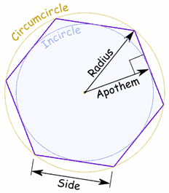
Important Terms to Know:
 | The furthest out circle is called a circumcircle, and it connects all vertices (corner points) of the polygon. The inner circle is called an incircle and it touches each side of the polygon at its midpoint. The radius of the circumcircle will also the radius of the polygon. The radius of the incircle is the apothem of the polygon.
http://reference.wolfram.com/legacy/v5_2/Demos/Notebooks/CalculatingPi.html

Slide 3
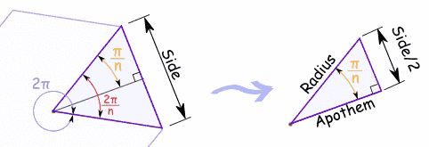
http://reference.wolfram.com/legacy/v5_2/Demos/Notebooks/CalculatingPi.html
---The point from the radius to one of the sides makes an equilateral triangle, then that split in half makes an isosceles triangle that can be used to find sin, cos, and tan of the triangle.

Slide 4
How that related to the Equation:
To find the area the tan would be used because it is Side = 2 × Apothem × tan(π/n) which would be used to find the area of the isosceles triangle, or since there is two smaller triangles per section then the Area of Polygon = n × Apothem2 × tan(π/n). This is why the formula is A(n)= n tan (180°/n).

Slide 5
find A(8), A (100), A (1000) and A(10000).
Plug into the equation A(n)= n tan (180°/n).

Slide 6
Answers: A(8)= 3.31371, A(100)= 3.14263, A(1000)= 3.1416, and A(10000)= 3.14159
--- we came to the conclusion that the larger A got, the closer our answers were to pi.

